Slide 1
Azure Governance Overview
Name

Slide 2
Azure Governance Workshop - Agenda
Why Governance?
Management Groups
Azure Policy /Initiatives
Blueprints
Resource Graph
Cost Management
Notes:
We built this workshop with the objective of raising awareness of the features available in Azure that will help organizations be more agile in implementing security controls as well as take a more proactive approach when dealing with Security. Most organizations today are very reactive and only respond to attacks when they already happened.
So here, we’ll dive in to various components available in Azure that you can use to help protect, detect, and respond to attacks.

Slide 3
Why is Governance needed?
Pressure to digitally transform & innovate
Need for agility to reduce speed to market
Shift to DevOps
Cloud Sprawl -> Increased complexity in managing standard, accountability, compliance, consistent architecture & cost ->
at Scale
Notes:
https://www.youtube.com/watch?v=ZuDg9-z8uuY
Companies are adopting the cloud to be more agile and save money. There’s pressure to digitally transform and innovate so you don’t have anymore the time to focus on your own infrastructure. You want to focus on making your customers happy by providing high-quality services that are supported by your engineering teams. So, there is a natural shift to DevOps in a Cloud environment where engineers will more rapidly provision the resources necessary to support a solution.
But this agility and easy access to resources has a price tag and many companies are struggling to control this Cloud Sprawl.
We’ve seen this before in early 2000 with the introduction of virtualization and virtualization sprawl. How did the industry react to that sprawl? <continues in next slide>

Slide 4

Traditional approach
Sacrifice Speed for Control
Developers
Cloud Custodian /
Engineers responsible for Cloud environment
Operations
Notes:
…this diagram speaks to that approach. We jump in front of the developers and operations and stop them before things get out of control. So we introduced a formal process for these teams to follow where they would fill out a form so the infra team could setup everything and in 2 weeks they would have access to their environment.
This approach in the Cloud era slows things down and you sacrifice speed in order to be in control.

Slide 5
Cloud-native governance
Speed and Control
Developers
Cloud Custodian Team
Built-in controls through policy instead of workflow
Operations
Notes:
In a cloud-native governance model you get the speed and control at the same time. So instead of you jump out in front of the DevOps team to make sure they are doing right things, the cloud platform itself is going to enforce that control on your behalf. This allows them to have complete access to the platform through a self-service model which is key to retain the agility and speed.
You can make sure your teams will deploy only approved resources and anything outside those rules are effectively denied.
This way, you keep your costs optimal and more predictable according to your budget.

Slide 6



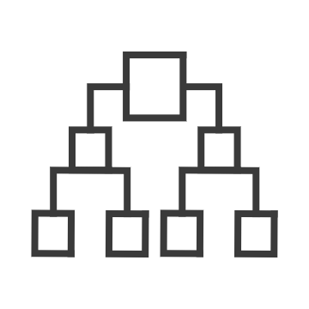
Governance for the cloud
Native platform capabilities to ensure compliant use of cloud resources
NEW
NEW
Policy
Blueprints
Resource Graph
Management Group
Cost
Real-time enforcement, compliance assessment and remediation
Deploy and update cloud environments in a repeatable manner using composable artifacts
Query, explore & analyze cloud resources at scale
Define organizational hierarchy
Monitor cloud spend and optimize resources
Control
Environment
Visibility
Hierarchy
Consumption
https://docs.microsoft.com/en-us/azure/cost-management/
Notes:
The capabilities that we have within the portfolio to deliver that level of control is what you see in the slide right now. These are all native platform capabilities, in other words, nothing here is a different product you need to acquire or deploy into your cloud environment. The moment you create your first subscription, these capabilities are there for you and are completely free.
Policy – this is where you will define what can or cannot be deployed in the Cloud. It will constantly scan your subscriptions and resources to make sure everything is within the corporate rules.
Blueprints – helps you setup your cloud environment that is properly governed and deployed in a repeatable manner. Subscriptions are provided to application teams or departments as they get onboarded. And the goal here is when they get onboarded to a governed subscription by Blueprints, the amount of time that they need to take from inception to production is going to dramatically decrease.
Resource graph – this is a big data technology where we bring all your resources configuration across the entire cloud environment and offer to you through a structure query language the ability to explore your environment very quickly allowing visibility at scale across your entire environment.
Management group - If your organization has many subscriptions, you may need a way to efficiently manage access, policies, and compliance for those subscriptions. This can be done through Management Group.
Cost – the notion of cost will be attached to all of these elements, but we won’t cover that in this module. You can refer to the link shown in the slide for more information.

Slide 7
Azure Governance Architecture
providing control over the cloud environment, without sacrificing developer agility
Policy Definitions
Role-based Access
ARM Templates
Management Groups
Azure Portal
CLI
3rd party
Environment Factory: Deploy and update cloud environments in a repeatable manner using composable artifacts
Subscriptions
CRUD
Query
Azure Blueprints
Policy Engine
Azure Resource Graph
Azure Resource Manager (ARM)
2. Policy-based Control: Real-time enforcement, compliance assessment and remediation at scale
3. Resource Visibility: Query, explore & analyze cloud resources at scale
Virtual Machine
Storage
Network
…
Resource Provider
Notes:
CRUD = create, read, update, delete
Let’s add those governance capabilities to a diagram.
Think about several apps teams or business units wanting to consume Azure resources to address their particular business requirements.
How many of these people, specially DevOps, will know by heart how to properly design and configure the networking components?
Ultimately you want a quick and efficient way to deploy and update cloud environments in a repeatable manner using composable artifacts
You would start by configuring your blueprints. And these blueprints would have all basic and required components for an entire solution, such as, your policy definitions, RBAC roles, ARM templates, number of subscriptions required, and the preliminary groups already granted the appropriate access levels to resources in that blueprint, such as your VMs, Storage accounts, Networking components and any other resource provider.
Lastly, you could leverage Resource graph to scan the environment to ensure, for example, if the number of resources are compliant with your budget.

Slide 8
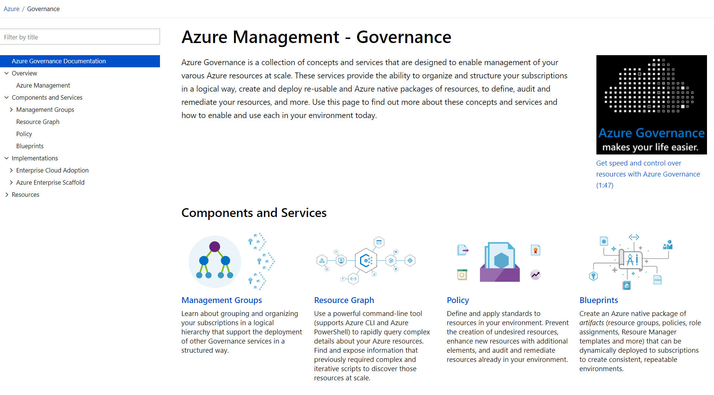
aka.ms/GovernanceDocs -or- docs.microsoft.com/azure/governance
Notes:
For more information please visit aka.ms….

Slide 9
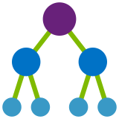
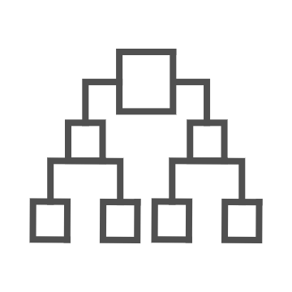
Introducing Azure Management Groups
Make environment management easier by grouping subscriptions together
Create a hierarchy of management groups that fit your organization
Apply governance controls with policies and access controls along with other Azure services
Grouping subscriptions into logical groups allow for new organization models
Inheritance allows for single assignment of controls that apply to all subscriptions
Aggregated views above the subscription level
Create a flexible hierarchy that can be updated quickly
Hierarchy doesn’t need to model the organizations billing hierarchy
Can easily scale up or down depending on the organizational needs
Azure Resource Manager (ARM) objects that allow integrations with other Azure services
Azure services:
Azure Policy
RBAC
Azure Cost Management
Azure Blueprints
Azure Security Center
Notes:
Let’s discuss further Azure Blueprints.
In terms of the best practices of setting up governance in your environment structuring your hierarchy and organizing your resources is the first critical step.
Everything you do, from setting RBAC rules to resources, to Azure Policy to Blueprint, all of these things hang on to the hierarchy and the first benefit of Mgmt Grp is inheritance. So whatever you apply at the top will be inherited down to the lowest level of your structure.
Let’s say a SOC team applies a set of security controls at the top to protect the entire environment. The problem today is that subscription owners can remove any control at the subscription level and many times you make the application teams owners of the subscription just because they need that flexibility. With Mgmt Group that option is now removed.

Slide 10
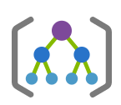
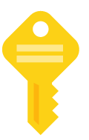
Management Group & Subscription
Modeling Strategy
Org Management Group
Prod RBAC + Policy
Pre-Prod RBAC + Policy
App A
Prod
App B
Prod
App A
Pre-Prod
App B
Pre-Prod
Microsoft Recommended
App D
Prod
Shared services
(Prod)
App C
Pre-Prod
Shared services
(Pre-Prod)
Notes:
You can also define more strict set of controls in production env vs test/pre prod for example. Or you may have a more cost-sensitive control in your test env.
Or you can totally isolate your test environment from the Internet…
Another benefit of Mgmt Grp is that if you made the wrong decisions setting up your controls you can create another mgmt grp hierarchy and move your subscriptions over without a pain.

Slide 11
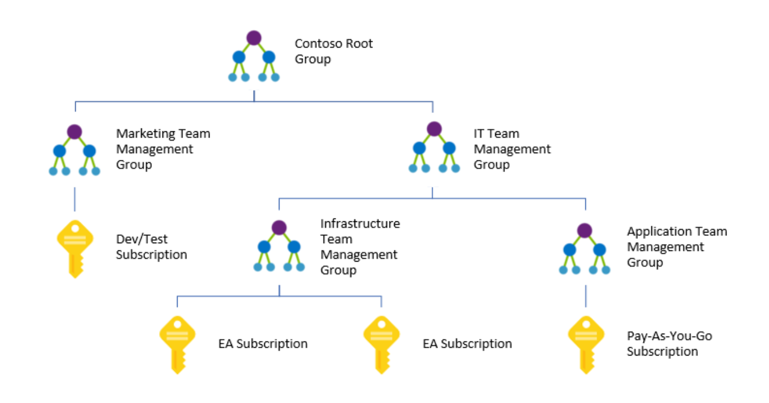

Slide 12
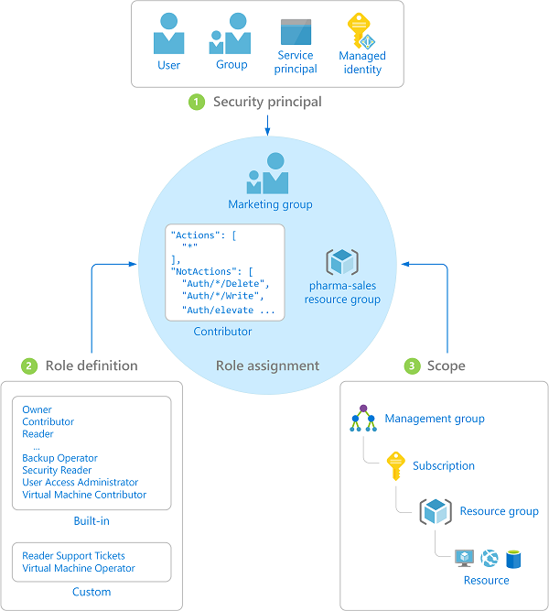
Azure Role-Based Access Control (RBAC)
Fine-grained access control to Azure “control plane”
Grant access by assigning Security Principal a Role at a Scope
Security Principal: User, group, or service principal
Role: Built-in or custom role
Scope: Subscription, resource group, or resource
Assignments are inherited down the resource hierarchy
https://aka.ms/azureiam
Notes:
Using RBAC, you can segregate duties within your team and grant only the amount of access to users that they need to perform their jobs. Instead of giving everybody unrestricted permissions in your Azure subscription or resources, you can allow only certain actions at a particular scope.
<CLICK1>
Security principal
A security principal is an object that represents a user, group, service principal, or managed identity that is requesting access to Azure resources.
- Service principal - A security identity used by applications or services to access specific Azure resources. You can think of it as a user identity (username and password or certificate) for an application.
Managed identity - An identity in Azure Active Directory that is automatically managed by Azure. You typically use managed identities when developing cloud applications to manage the credentials for authenticating to Azure services.
<CLICK2>
Role definition
A role definition is a collection of permissions. It's sometimes just called a role. A role definition lists the operations that can be performed, such as read, write, and delete. Roles can be high-level, like owner, or specific, like virtual machine reader. You can create custom roles if none of the existing built-in roles don't meet the specific needs of your organization.
<CLICK3>
Scope
Scope is the boundary that the access applies to. When you assign a role, you can further limit the actions allowed by defining a scope. This is helpful if you want to make someone a Website Contributor, but only for one resource group.

Slide 13

Azure Policy
Turn on built-in policies or build custom ones for all resource types
Apply policies to a Management Group with control across your entire organization
Real time remediation
Real-time policy evaluation and enforcement
Apply multiple policies and & aggregate policy states with policy initiative
Remediation on existing resources (NEW)
Periodic & on-demand compliance evaluation
Exclusion Scope
VM In-Guest Policy (NEW)
Enforcement & Compliance
Apply policies at scale
Remediation
Notes:
Policy is the backbone of enforcement and compliance in Azure. Compliance is an evolving landscape that you will always need to evaluate and adjust according to the needs of the present time. You also need to plan carefully your policies so you don’t disrupt other unities that require a more flexible policy than the one you defined.
Through policies, you can control the types of resources that can be provisioned. Or, you can restrict the locations in which the resources can be provisioned. Unlike RBAC, policy is a default allow and explicit deny system.
Azure Policy is a service that you use to create, assign and, manage policy definitions. Policy definitions enforce different rules and actions over your resources, so those resources stay compliant with your corporate standards and service level agreements.
Policy focuses on resource properties during deployment and for already existing resources.
Azure Policy runs an evaluation of your resources, scanning for those not compliant with the policy definitions you have.
VM guest policy: this is a new feature that extends the policy capability to the resources running inside your VMs

Slide 14




Azure Policy
ARM – Centralized Control Plane
Azure Policy
User
Resource
Config
Request
Code
Notes:
This is how Azure Policy can help with governance.
Your DevOps request to deploy resources to Azure for a given project through a JSON template they pre-created to make things easier and quicker. Let’s say they want to deploy 5 G series VMs in Europe (high memory-to-cpu ratio and are ideal for DB servers) and 5 Ls in the US (high disk throughput, ideal for big data and SQL)
Azure Policy takes action and scans

Slide 15


Azure Policy
ARM – Centralized Control Plane
Azure Policy
User
Resource
Config
Request
Cloud Resource
Code

Slide 16

Azure Policy
ARM – Centralized Control Plane
Azure Policy
User
Cloud Resource
Cloud Resource
Code
Cloud Resource

Slide 17
Policy Language
{
"if": {
<accessor>, <condition> | <logical operator>
},
"then": {
"effect": “Disabled | append | deny | audit | auditIfNotExists | deployIfNotExists"
}
}
Operators
“not”: { … }
“allOf”: [ … ]
“anyOf”: [ … ]
Fields
name
kind
type
location
fullName
tags
tags.*
aliases
Conditions
“equals”: “value”
“like”: “value”
“match”: “value”
“contains”: “value”
“in”: [“val1”, “val2”]
“containsKey”: “keyName”
“exists”: “bool”
+ “not*” variants
Accessors
“field”: “fieldname”
“source”: “action”
Notes:
Order of evaluation
Requests to create or update a resource through Azure Resource Manager are evaluated by Policy first. Policy creates a list of all assignments that apply to the resource and then evaluates the resource against each definition. Policy processes several of the effects before handing the request to the appropriate Resource Provider. Doing so prevents unnecessary processing by a Resource Provider when a resource doesn't meet the designed governance controls of Policy.
Disabled is checked first to determine if the policy rule should be evaluated.
Append is then evaluated. Since append could alter the request, a change made by append may prevent an audit or deny effect from triggering.
Append is used to add additional fields to the requested resource during creation or update. A common example is adding tags on resources such as costCenter or specifying allowed IPs for a storage resource.
Deny is then evaluated. By evaluating deny before audit, double logging of an undesired resource is prevented.
Deny is used to prevent a resource request that doesn't match defined standards through a policy definition and fails the request.
Audit is then evaluated before the request going to the Resource Provider.
Audit is used to create a warning event in the activity log when evaluating a non-compliant resource, but it doesn't stop the request.
After the Resource Provider returns a success code, AuditIfNotExists and DeployIfNotExists evaluate to determine if additional compliance logging or action is required.
AuditIfNotExists (exiting resources)
AuditIfNotExists enables auditing on resources that match the if condition, but doesn't have the components specified in the details of the then condition.
DeployIfNotExists
Similar to AuditIfNotExists, DeployIfNotExists executes a template deployment when the condition is met.

Slide 18
Policy definition
$policy = New-AzureRmPolicyDefinition -Name costCenterTagPolicyDefinition -Description "Policy to deny resource creation if no costCenter tag is provided" -Policy '{
"if": {
"not" : {
"field" : "tags",
"containsKey" : "costCenter"
}
},
"then" : {
"effect" : "deny"
}
}'

Slide 19
Enforce naming convention
{
"if": {
"not": {
"field": "name",
"like": "namePrefix*nameSuffix"
}
},
"then": {
"effect": "deny"
}
}

Slide 20
Enforce VM SKUs of basic A series
"properties": {
"displayName": "Allowed VM Skus",
"description": "This policy enables you to specify a set of virtual machine SKUs that your
organization can deploy.“
},
"policyRule": {
"if": {
"allOf": [
{
"field": "type",
"equals": "Microsoft.Compute/virtualMachines“
},
{
"not": {
"field":"Microsoft.Compute/virtualMachines/sku.name",
"in": ["Basic_A0”,”Basic_A1”,”Basic_A2”,”Basic_A3”,”Basic_A4”]
}
}
]
},
"then": {
"effect": "Deny“
}
}

Slide 21
Enforce VM SKUs using parameters
"properties": {
"displayName": "Allowed VM Skus",
"description": "This policy enables you to specify a set of virtual machine SKUs that your
organization can deploy.",
"parameters": {
"listOfAllowedSKUs": {"type": "array"}
}
},
"policyRule": {
"if": {
"allOf": [
{
"field": "type",
"equals": "Microsoft.Compute/virtualMachines“
},
{
"not": {
"field":"Microsoft.Compute/virtualMachines/sku.name",
"in": "[parameters('listOfAllowedSKUs’)]”
}
}
]
},
"then": {
"effect": "Deny“
}
}

Slide 22
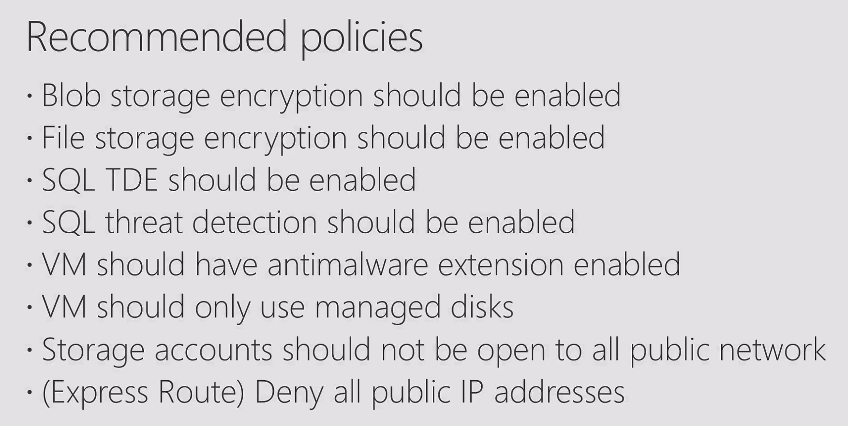

Slide 23
Azure Policy Best Practices
What is involved in defining a new Policy or refining an existing one?
What drives your need for Policy?
Who owns policy definitions & implementation?
Regulatory Compliance
Controlling cost
Standards & Tagging
Maintain security and performance consistency
Enforce enterprise wide design principles
“Initiative" owners like Security Architect or Cloud Architect or Cloud Engineers
Research or gather evidence on the impact of a particular configuration on a particular fundamental (like cost or security)
What-if analysis of enforcing configuration in a particular manner
Assess the current state of compliance to understand the impact of new policy and what exceptions are needed
Roll out new policy in phases
Understand the applications & teams who are non-compliant
Rollout remediation in stages via SafeDeploy practices
Notes:
Ask yourself these 3 questions and work from there when defining your policies
What drives your need for policy?
Who owns policy definitions?
What is involved in defining a new policy or refining an existing one?
These questions need to be asked from time to time as compliance is an evolving thing. You need to adjust your policies according to your current priorities, not only for compliance, but also for different projects that might require more powerful resources deployed that are currently blocked by policy, for example.

Slide 24
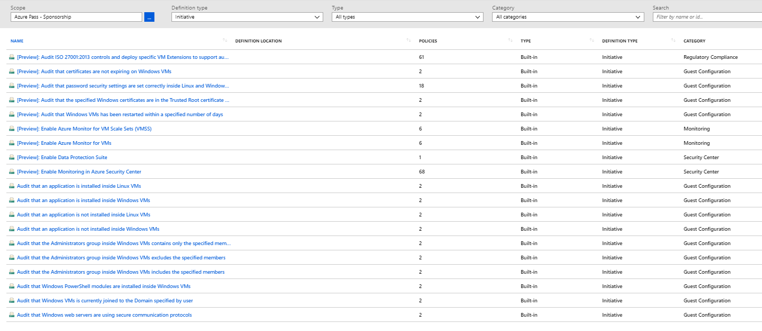
Policy Initiatives
Examples:
Azure Policy's Guest Configuration
Industry security baselines such as CIS/STIG/ISO27001
Out of box

Slide 25

Cloud Factory
Customer Challenges
No central way to compose and enforce what goes into or made available in a subscription.
Challenging to setup foundational infrastructure
Subscription owners can modify resources and remove policies breaking best practices defined by Cloud Architects
No way to codify best practices
Notes:
How can you bring everything already discussed in a structured manner, so you can setup your environment in a consistent and automated way, at scale in the least time possible?
For a developer, there’s a lot to do when they first onboard to an Azure subscription. As one might say, Azure is an empty canvas and if you are not an artist there’s quite a lot of drawing to do. And trying to fill up that canvas with a baseline picture is what really Blueprint is about. It tries to create a foundational basis of what your environment would look like.
There is no reason why your DevOps would become a ninja in Azure networking, they just need to focus on their coding, business logic, etc and that’s it.
What happens today is you either provide them with a giant document with all specifications required and setup numerous meetings with them to make sure they understand and follow those specifications, or you just make everything for them, which increases the deployment time as there would be a line up of other devops waiting for their environment to be provisioned.

Slide 26



Azure Customer Challenges
Designing and Building Governed Azure Subscriptions
Challenging to setup foundational infrastructure
Cumbersome to create and redeploy infra.
Takes ~7 months to setup foundational infra
Inability to create governed subscriptions
No central way to compose and enforce what goes into or made available in a subscription. Customer use a ton a scripts to try and accomplish this.
Protecting foundational resources
Subscription owners can modify resources and remove policies breaking best practices defined by Cloud Architects

Slide 27
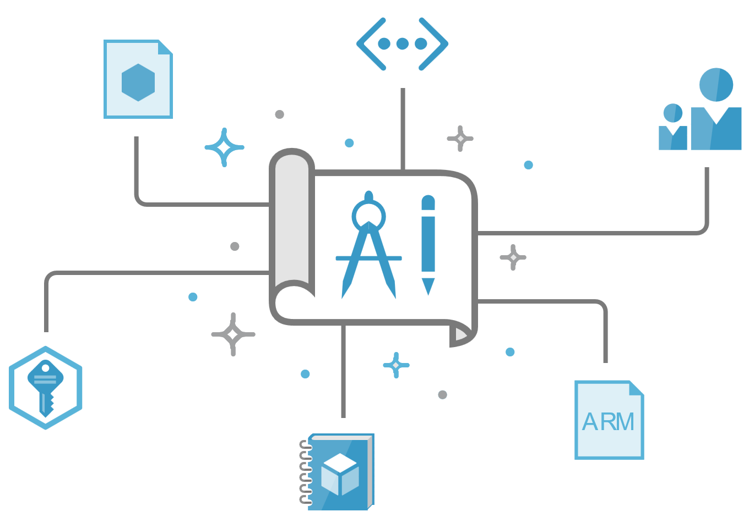

Introducing Azure Blueprints solution
automated, easy-to-deploy solution to help setup governed Azure Subscriptions
Compose
Orchestrate
Protect
Empower
Let app teams use Azure in a self-service manner while ensuring organizational standards
Compose, deploy and update cloud environments in a repeatable manner
Orchestrate deployment of Resource Templates, Policies, and RBAC
Lock down foundational infrastructure that are shared across subscriptions
Notes:
It’s a tracked entity.

Slide 28
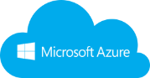



How Blueprints work?
1
Contoso Blueprint
Creates a Blueprint
Cloud Engineer
Cloud Engineer
2
Policies
Adds artifacts (azure resources) to be used
Foundational Templates
4
Apply Blueprint to Scope (MG, Sub)
RBAC
Identifies artifacts to be instantiated by default.
Sequence Deployments
Scripts
3
Azure Subscription created and secured
Curated Marketplace*
Other Templates
Deployed and locked foundational artifact

Slide 29



Azure Blueprints
deploy and update cloud environments in a repeatable manner using composable artifacts
Role-based access controls
Policy Definitions
Subscription A
ARM Templates
Azure Blueprints
Subscription B
Subscription C
…
compose
manage
scale

Slide 30
Customer requested scenarios
Cost Visibility per Blueprint: Ability to view cost of Blueprint managed resources
Sub creation with Blueprint deployment: Ability to create subscriptions while assigning a Blueprint (increase the 50subs per account limit)
Integrate Blueprint assignment in sub creation experience: Ability to pick a Blueprint in the subscription creation portal experience.

Slide 31
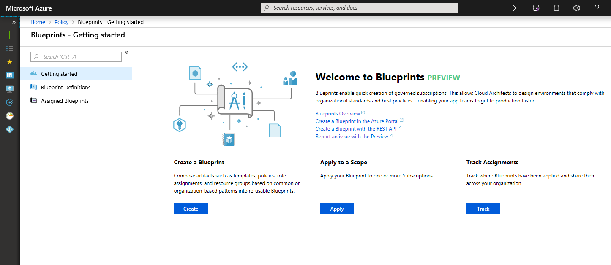

Slide 32



Azure Resource Graph
Query, explore & analyze cloud resources at scale
Explore
Query & Analyze
Impact Assessment
Perform fast ad hoc exploration in large cloud environment
Query & analyze across all of your cloud resources at scale in seconds
Ability to assess the impact of applying policies in vast cloud environment
Notes:
There are a few challenges today when it comes to getting visibility of all your resources properties in all subscriptions and understand how they can be impacting negatively your organization, being from a cost or a security perspectives.
Inability to view resources and their properties across subscriptions
Query resources (without worrying about timeouts & throttling), including filtering, grouping and sorting of resources by resource properties
Resource graph provides a way to interactively explore resources, so you can assess the impact of applying policies in vast cloud environment
Demo:
Launch Resource Graph in the portal and show the example query commands
Launch CloudShell and run those command examples

Slide 33


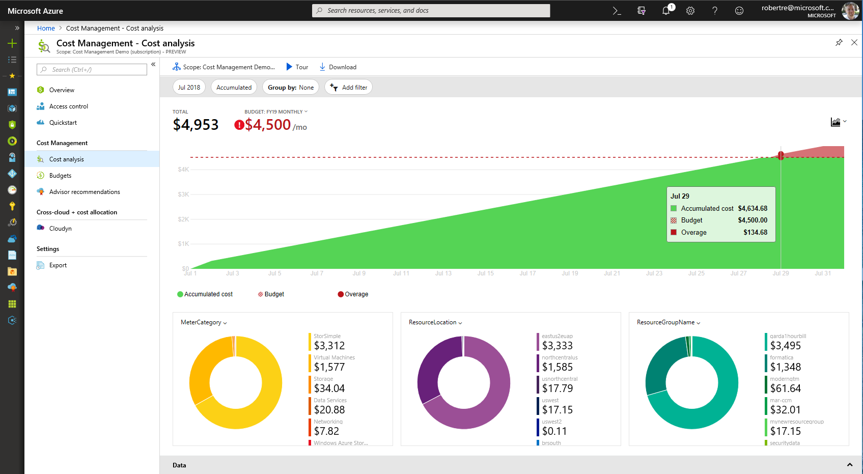
Azure Cost Management Built into Azure
NEW
On by default
Better experience for more users
Richer analysis and budget alerting
Integrated with Azure Advisor
Reduced data latency by up to 80%
Free to manage Azure costs

Slide 34

Continuous cost optimization process
Optimization
Visibility
Accountability
Management teams
Finance teams
App teams

Slide 35
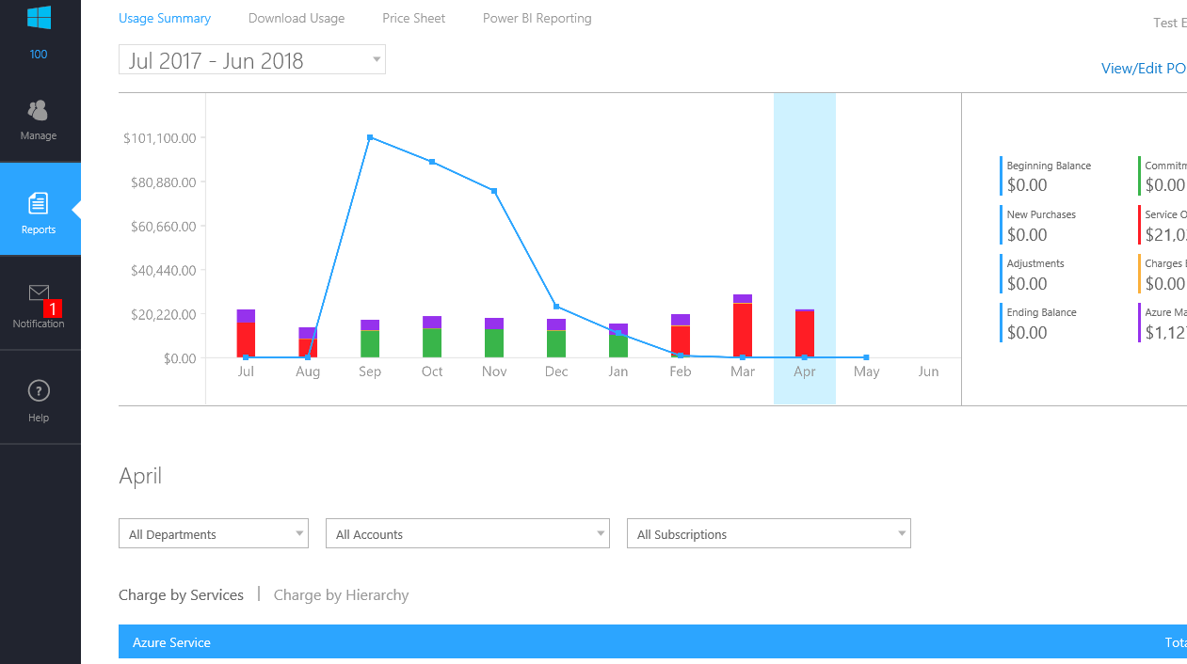
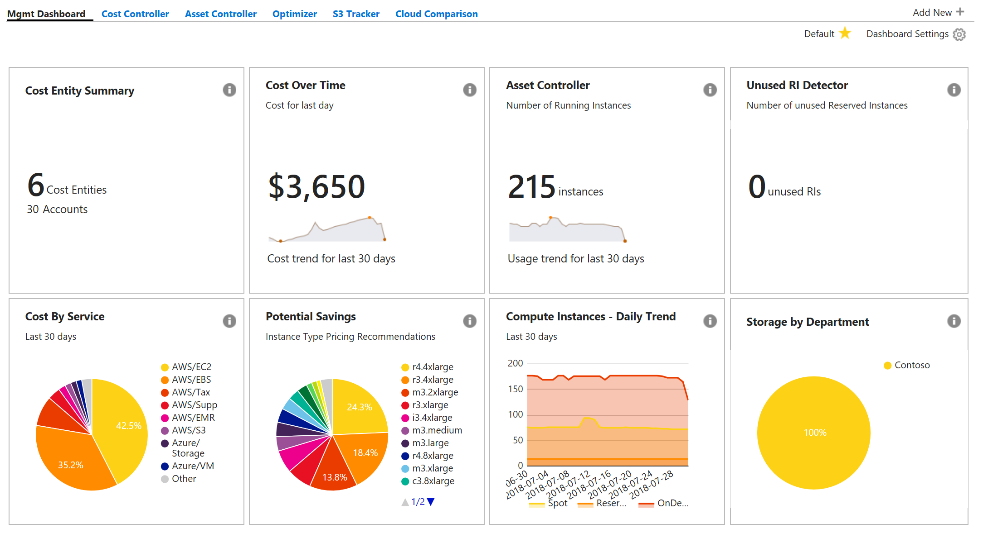
Bring the best together in Azure Portal
Enterprise Portal
Azure Cost Management
Cost Management By Cloudyn
Notes:
Reducing # of portals…and we will cover details in upcoming slides..

Slide 36
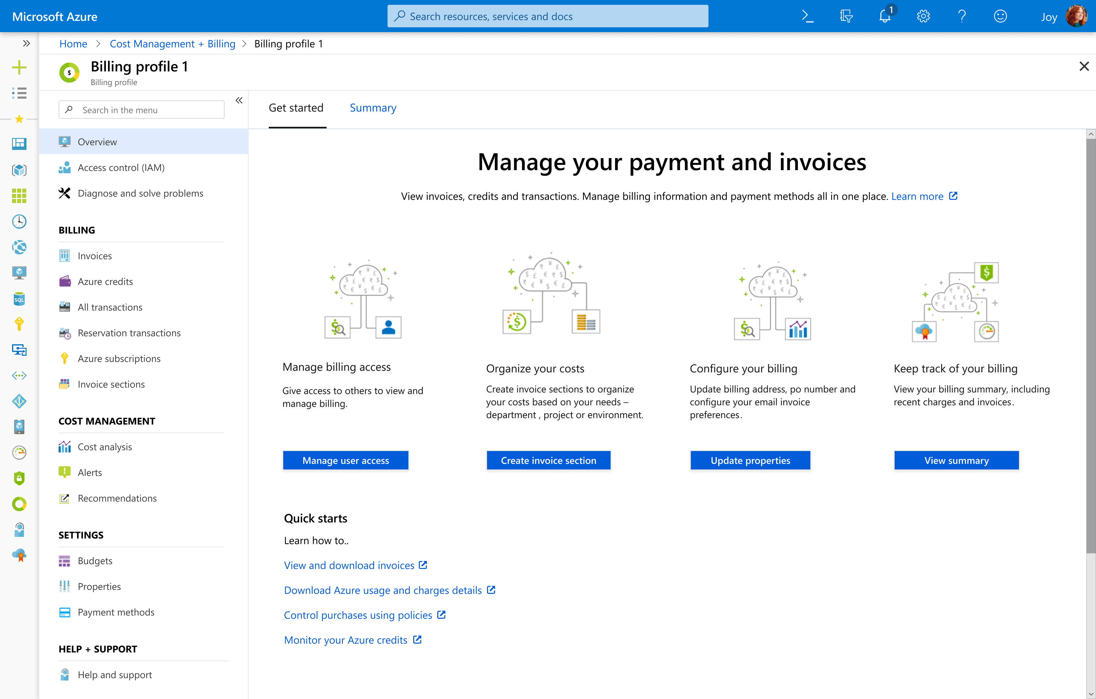
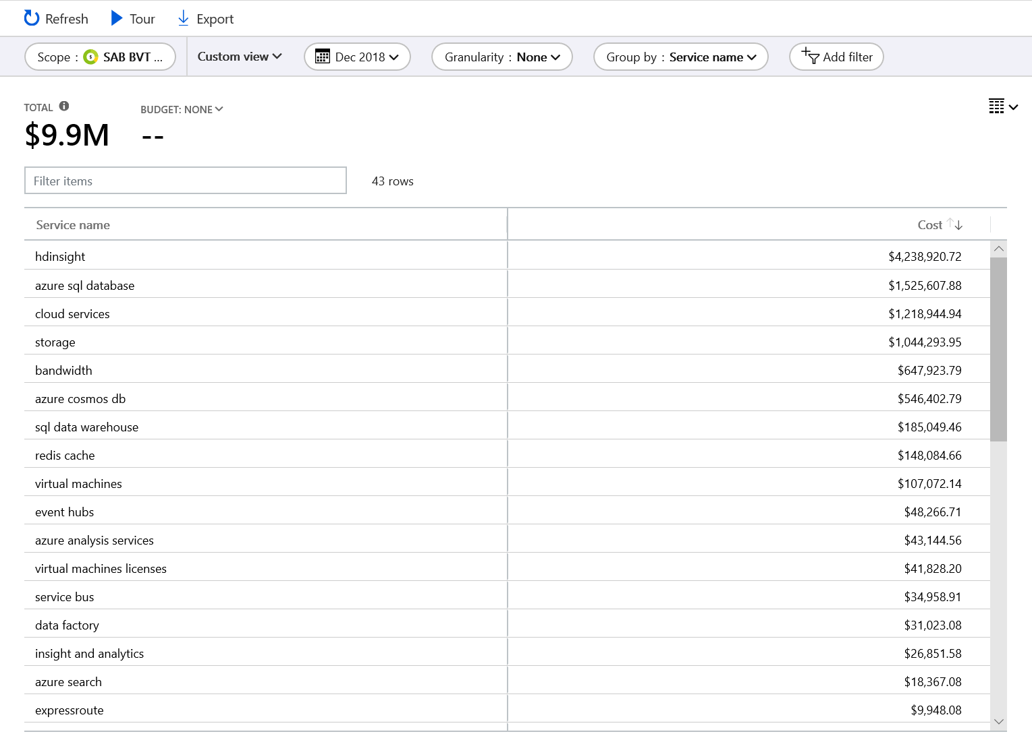
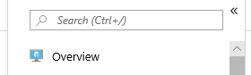
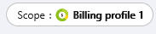
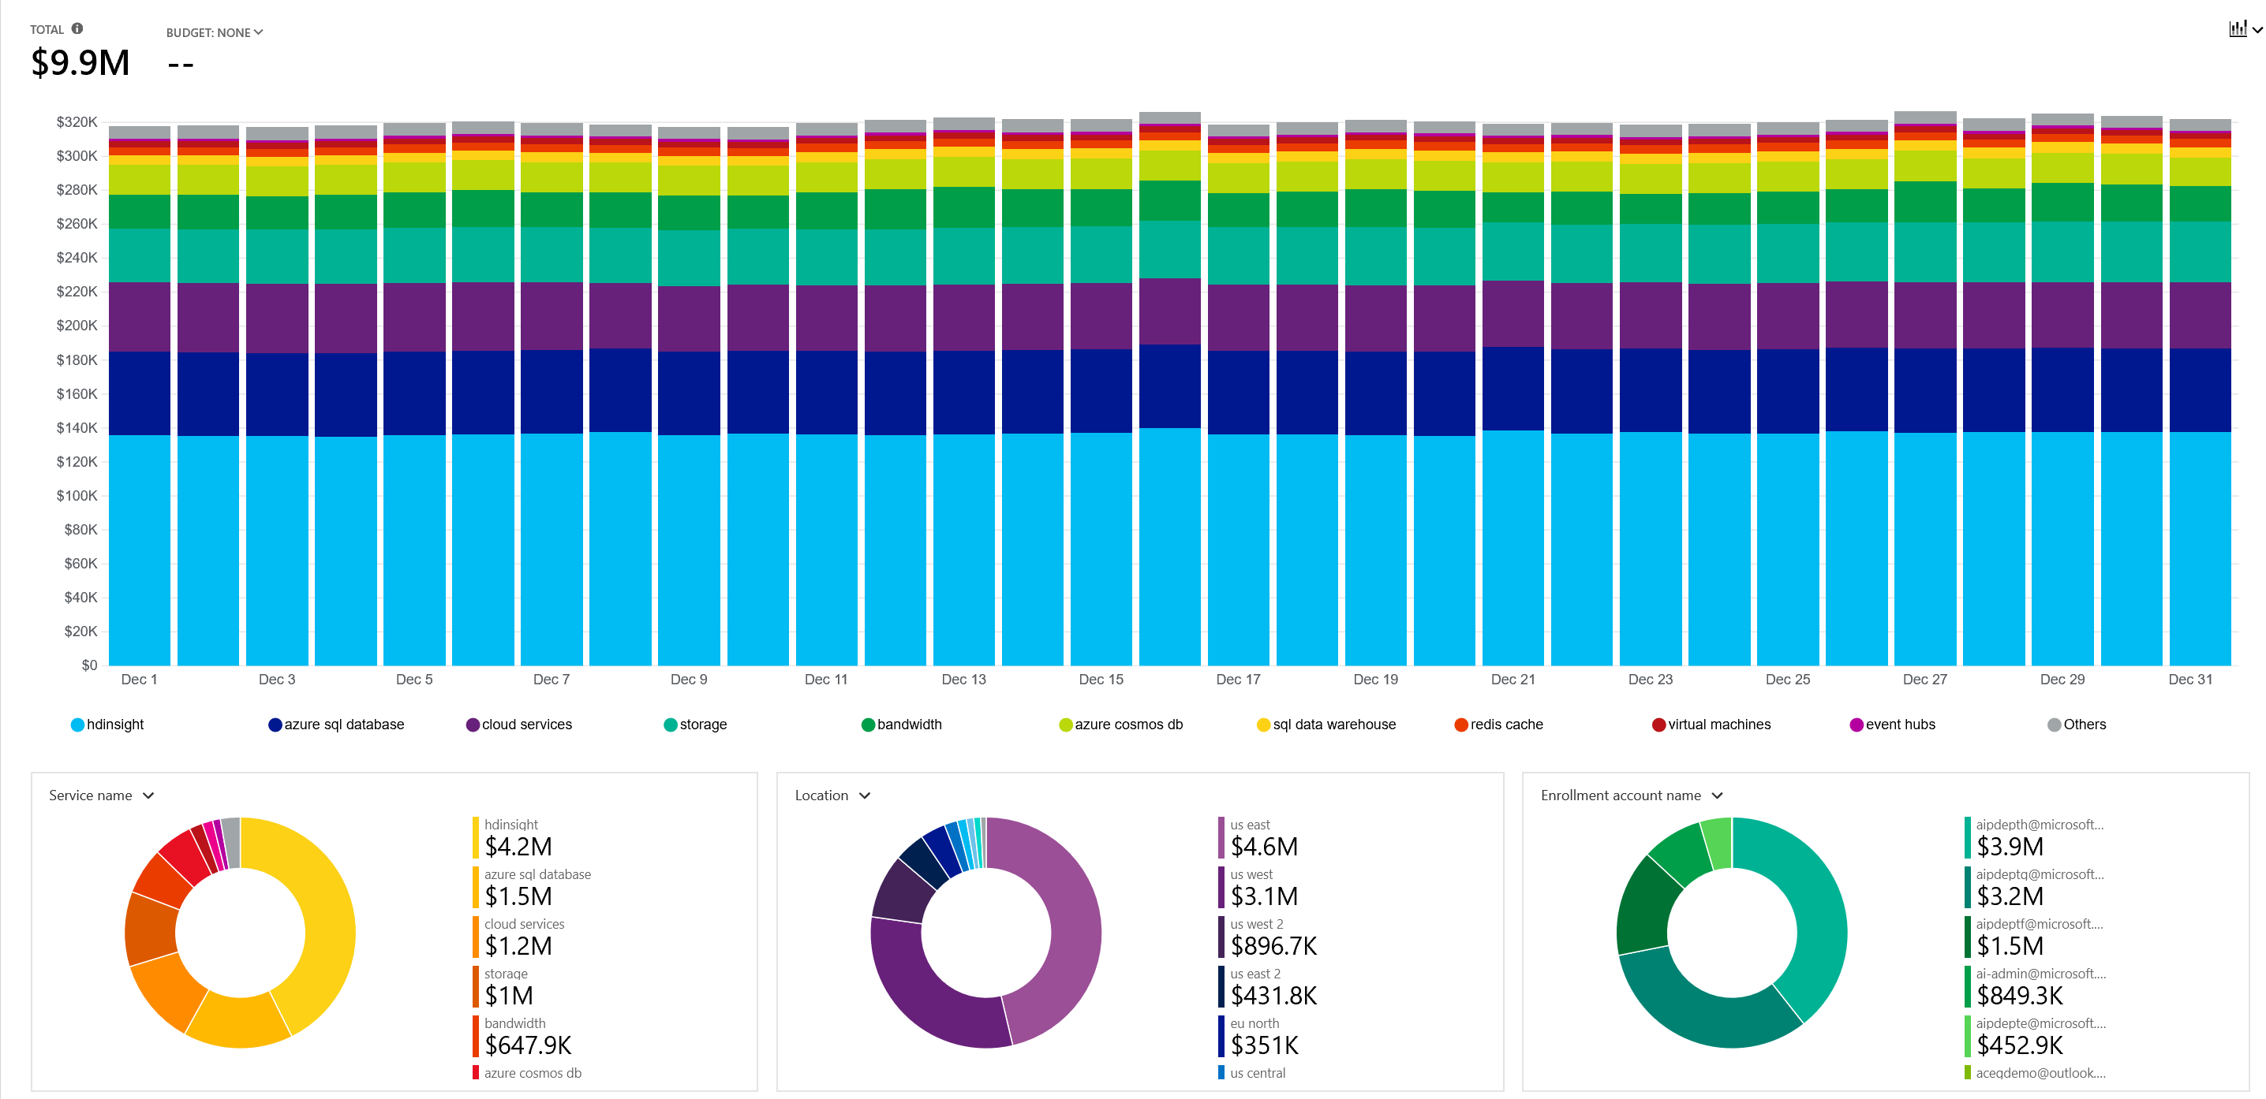
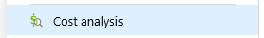
Cost Analysis
Detailed Cost Exploration
Group, filter and view by 14 dimensions
Date Ranges
Daily, accumulated, monthly grain
Saved and scheduled reports
Integrated with Budgets
Enrollment, subscription, management group and resource group scope
Notes:
Ability to slice and dice your data and analyze this on multiple dimensions..

Slide 37
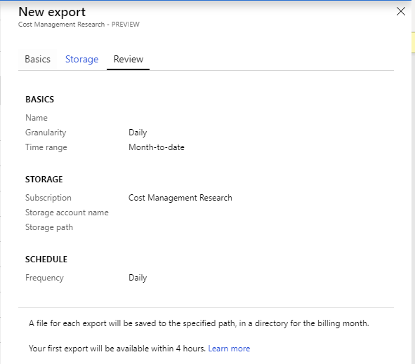
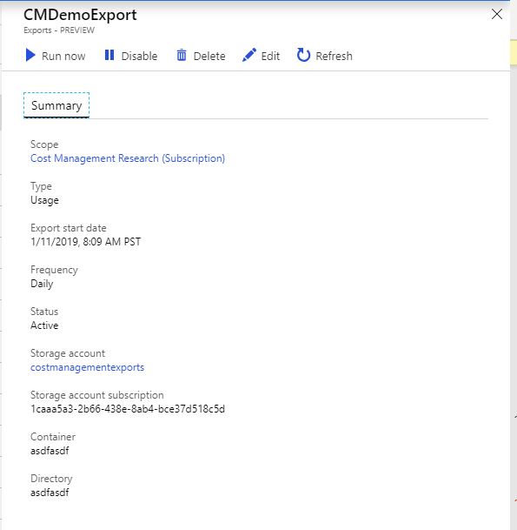
Exports data to your storage account
Schedule exports for subscription data
Automatically loaded to storage account
Integrated into cost analysis

Slide 38
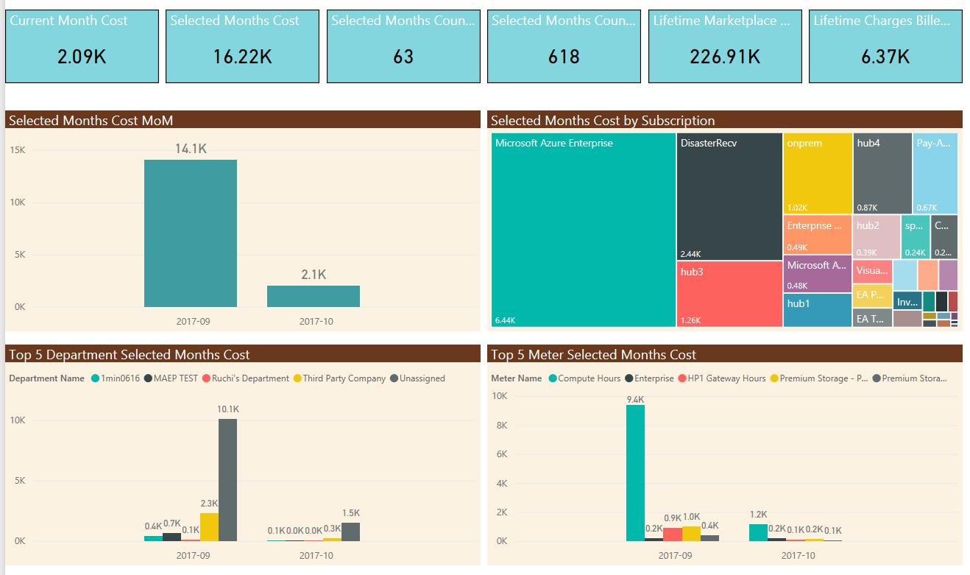
Power BI Content Pack

Slide 39
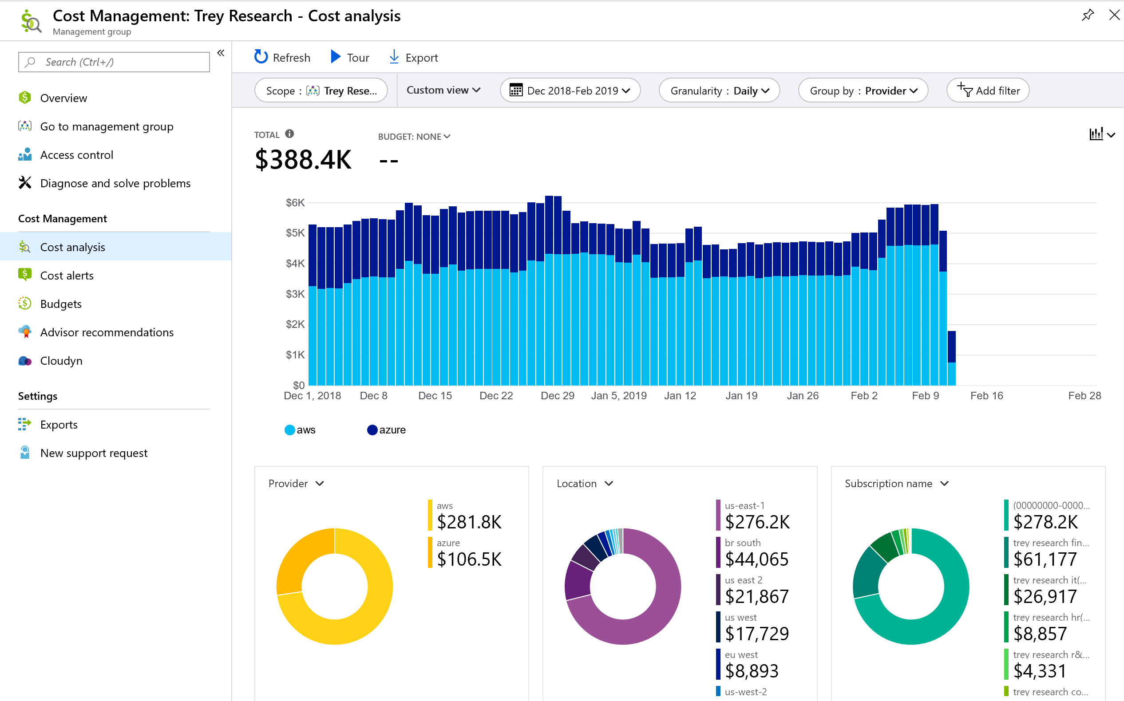
Cost Management support for Cross Cloud - AWS
We also have AWS spend available in ACM
Analyze your costs across Azure & AWS
Currently in private preview

Slide 40
Keys to accountability
Extend visibility to stakeholders
Management groups, RBAC, and tagging
Management teams
Set clear goals
Budgets and alerts
Finance teams
Hold teams accountable for improvement
App teams

Slide 41
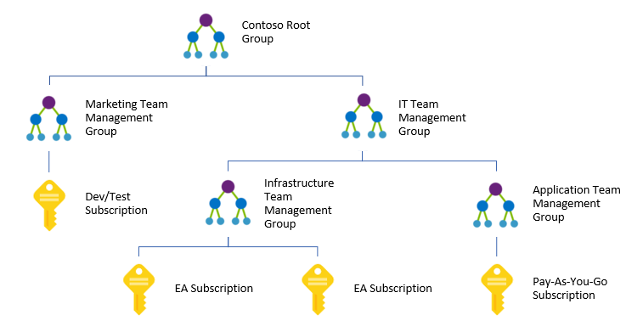
Management Groups to organize subscriptions
Create a custom management hierarchy to fit your organization
Enables RBAC, policies for tagging, cost analysis and budgets at any scope
Shared with Policy, Security Center, Privileged Identity Management services

Slide 42
Least-privileged RBAC roles
Azure RBAC Role | Description | Example Personas
Cost Management Reader | Read access to all cost mgmt. features, but no changes allowed | Azure service owner, it dev ops, finance analyst
Cost Management Contributor | In addition cost management reader can create budget and alert creation | Azure service owner, finance manager, dept. or product owner
Billing Reader | Has read-only access to billing information in Azure portal | Finance manager
Reader | Read access
Contributor | Lets you view everything, but not make any changes
Owner | Lets you manage everything, including access to resources

Slide 43
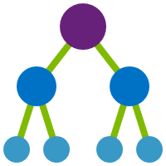


Tags add context for cost analysis
Finance codes - CostCenter tag, etc.
Application context - AppService tag, etc.
Deployment context - Environment tag, etc.
Who is accountable - BusinessOwner tag, etc.
Tags should be enforced by configuration policies
Use Azure Policy to set and track ARM tagging policies
MG, Subscription, RG scopes
Enforce that tags exist
Set default values for tags
Audit if tags are missing
##
###
#
##
TAG = #

Slide 44
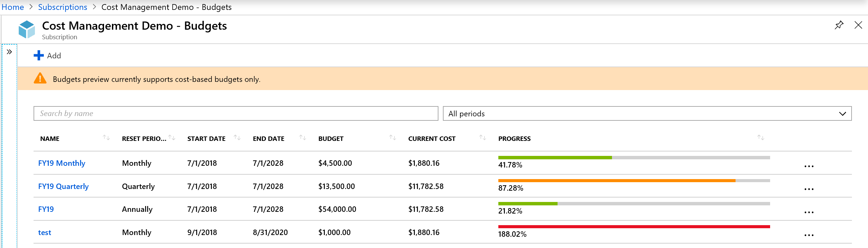
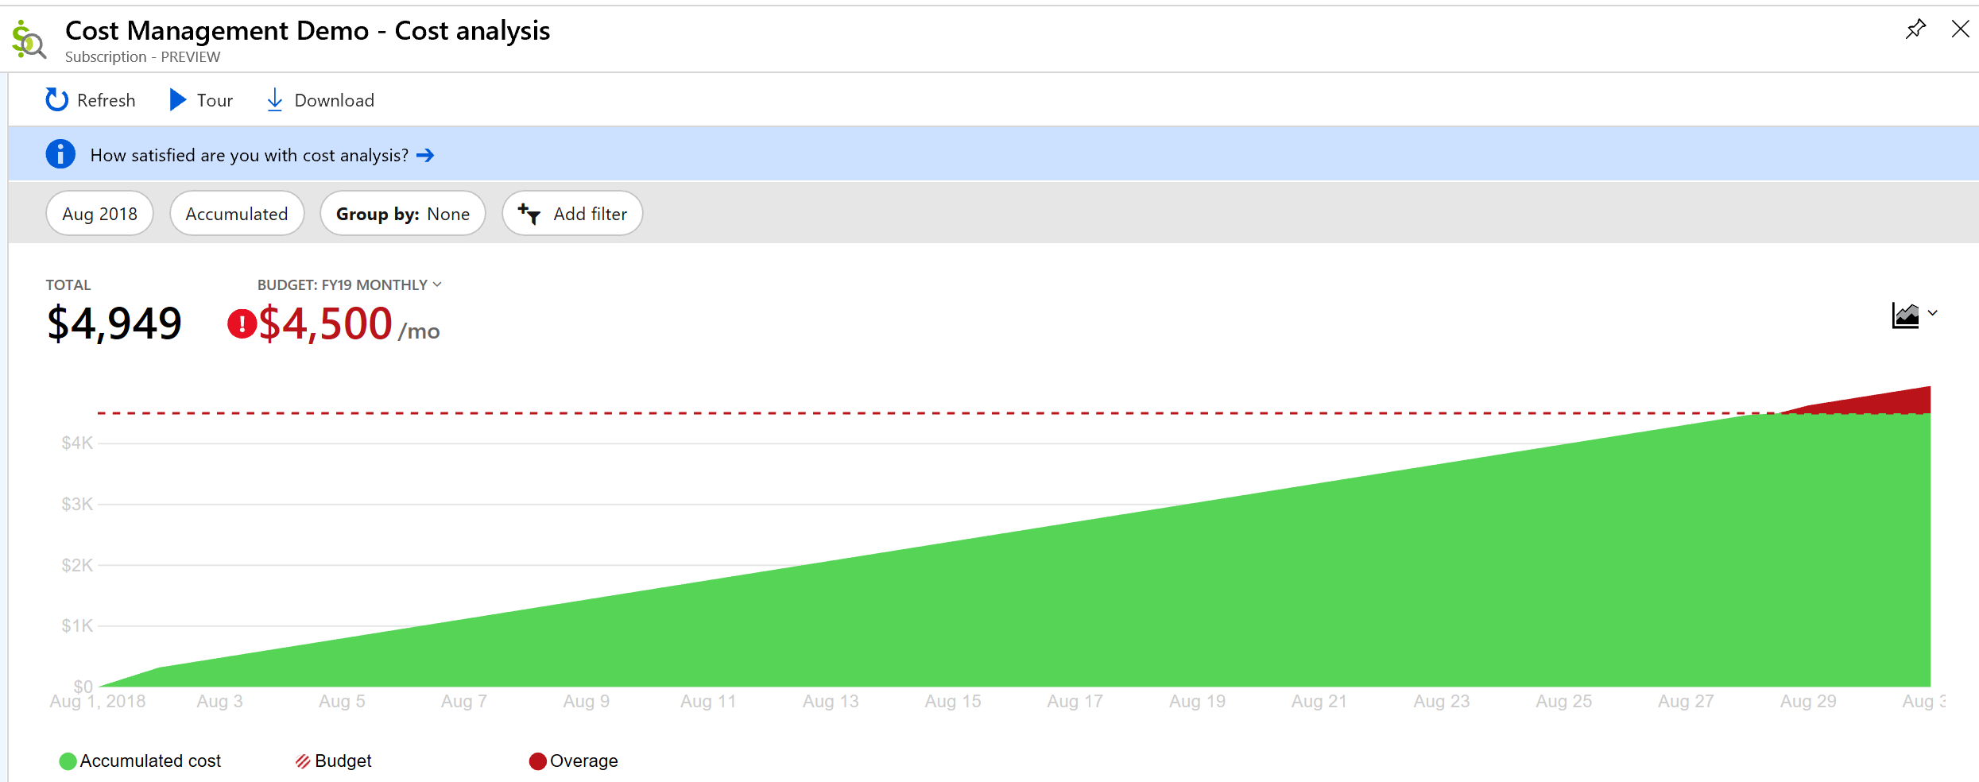
Budgets for monitoring and notifications
Monitor your costs using budgets
Get notified when threshold are met
Automate with Action Groups
Integrated into cost analysis

Slide 45

Cost optimization is a key to cloud success
The workload will run fine in all three VM sizes
Which will a developer naturally choose?
Which will deliver more success to the business?
Which one will make managers and finance want more things in the cloud?
VM1
VM2
VM3
Workload
Workload
Workload
How do you know when there are opportunities to optimize?

Slide 46
Azure Advisor provides optimization recommendations
Cost
High Availability
Security
Performance
Maximize the return of your IT budget investment
Improve the availability of your business-critical applications
Enhance protection of your Azure resources from potential security threats
Optimize performance to make the most of your resources
Resource recommendations (right-sizing, idle, etc.)
Purchasing recommendations (reserved instances, etc.)

Slide 47
Scenario 1: Tracking costs for Departments & Environments
Biz Unit 1
(EA Department)
Dev
(Subscription)
Test
(Subscription)
Biz Unit 3
(EA Department)
Customer Support Tools
Biz Unit 2
(EA Department)
Dev
(Subscription)
Test
(Subscription)
Production
(Subscription)
Production
(Subscription)
Mimic hierarchy using Management Groups
Policies can be enabled for Management Groups & Subscriptions
RBAC access can be enabled for management groups and/or subscriptions

Slide 48
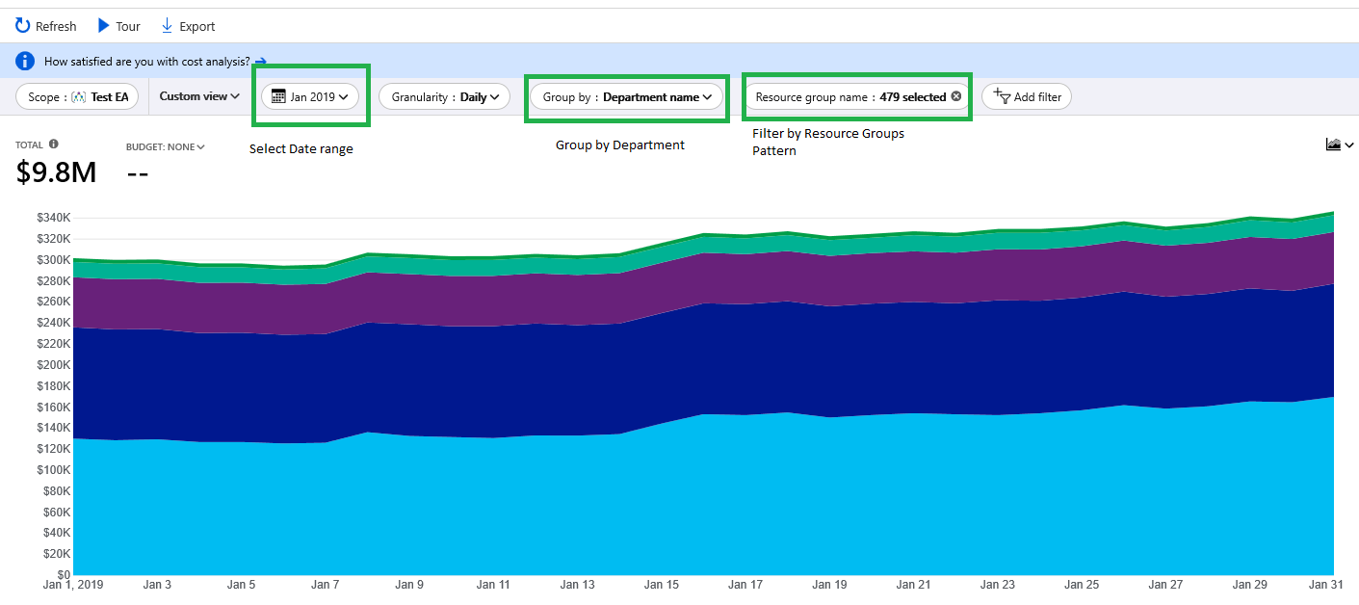
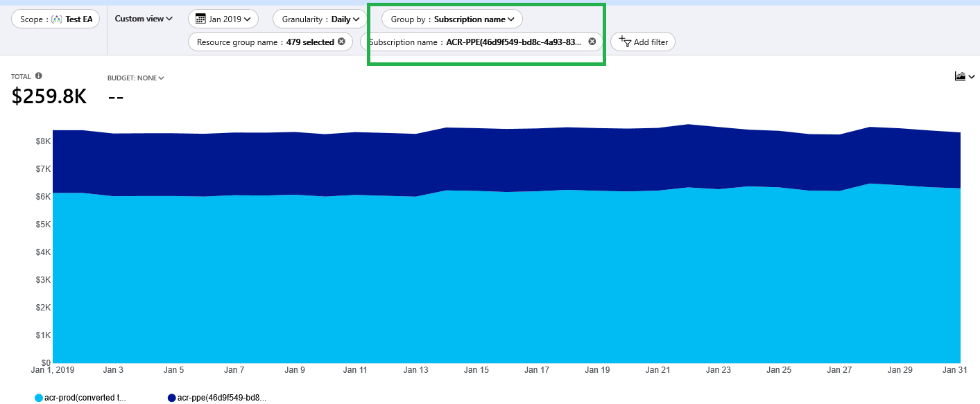
Scenario 1: Cont’d
Cost by Department
Cost by Environments

Slide 49
Scenario 2: Tracking Project Level costs
Biz Unit 1
CostMgmt_Dev
myProject_UI
myProject_Db
Department
Subscription
Resource Group
Use RGs and/or Tags to track project costs
Having organizations standards to name RGs or Tags recommended
RBAC access can be enabled for RGs but not for tags
RGs don’t span across subscriptions

Slide 50
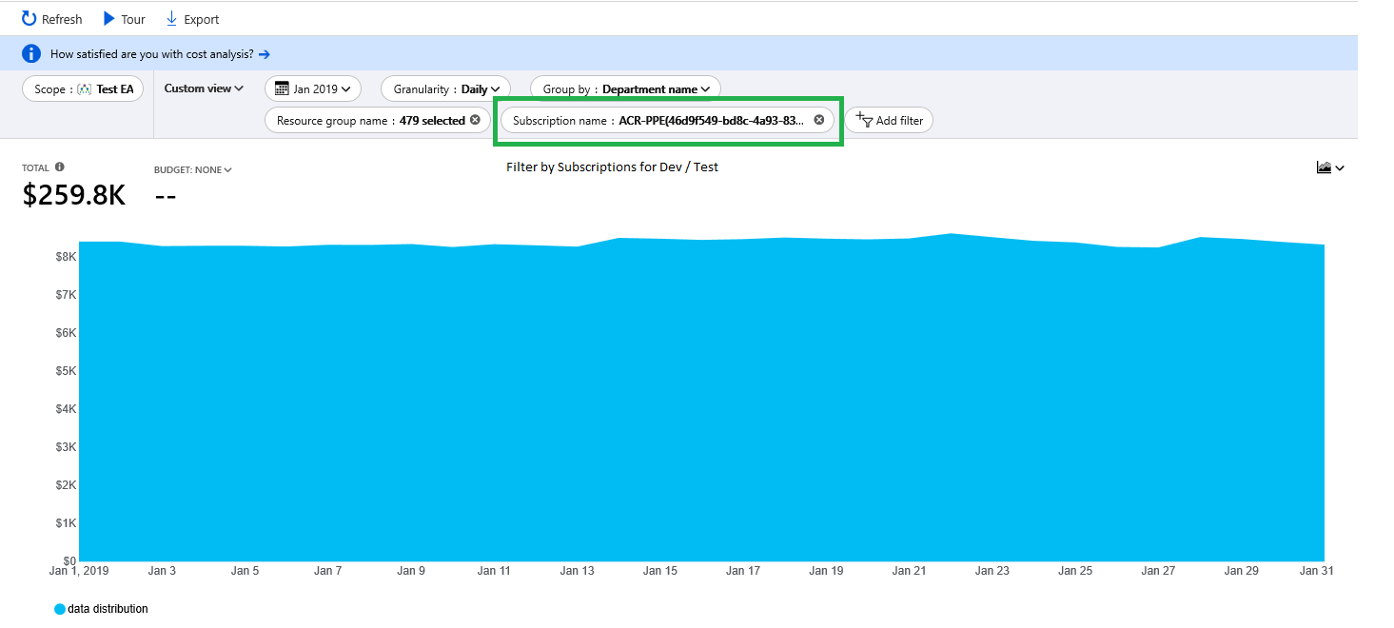
Scenario 2: Cont’d

Slide 51
Reinvest your savings
Migrate
Modernize
Secure and manage
Reinvest the money saved on migrating more workloads
Reinvest the money saved on modernizing workloads
Reinvest the money saved on adding security and management

Slide 52


Get started today!
Manage your EA costs with Azure Cost Management preview
1
2
Use Azure Reserved Instances and Hybrid Use Benefits to save
3
Reinvest your savings to get even more business value out of Azure

Slide 53
Where to go for more information
Azure Cost Management product page
https://azure.microsoft.com/services/cost-management/
Azure Cost Management documentation
https://docs.microsoft.com/azure/cost-management/
Azure Cost Management API reference
https://docs.microsoft.com/rest/api/cost-management/
FastTrack for Azure (deployment guidance)
https://azure.microsoft.com/programs/azure-fasttrack/
Twitter @AzureCostMgmt

Slide 54
References
Ignite 2018 Sessions
BRK3062 - Architecting Security and Governance Across your Azure Subscriptions Joseph Chan, Satya Vel Sep 25th
BRK3085 - Deep dive into Implementing governance at scale through Azure Policy Liz Kim, Tigran Shahbazian Sep
Policies GitHub

Slide 55
Azure Governance Workshop\Lab

Slide 56
Module 1 - Azure Governance
Section 1
Subscription Management Overview
Notes:
RBAC is present in every Azure service and it is the foundation for securing your resources by granting the appropriate access level required to securely manage your environment.
Differently from an on premises Active Directory where you would need to deploy extra solutions (i.e. MIM) to achieve RBAC functionality, in Azure there are pre-defined groups with their corresponding permission levels ready to use, as well as the possibility to customize your own RBAC model according to your needs.
Please update the content of this slide Add the other objectives

Slide 57

Management groups for enterprises
Organizational alignment for your Azure subscriptions through custom hierarchies and grouping
Enables targeting of policies and spend budgets across all subscriptions and inheritance down the hierarchies
Enables compliance and cost reporting by organizations (business/teams)

Slide 58
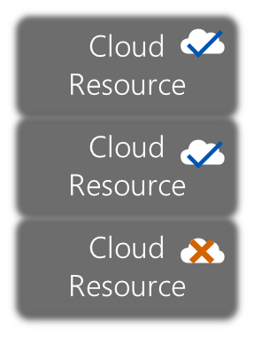
How does it work?
ARM – Centralized Control Plane
Org Hierarchy
Azure Policy
User
Subscription
Subscription
Code

Slide 59
How does it work?
ARM – Centralized Control Plane
Org Hierarchy
Azure Policy
Mgmt group
User
Subscription
Subscription
Code

Slide 60
Enterprise Azure Roles and Portals
Enterprise Portal
Enterprise Administrator : https://ea.azure.com
Add other Enterprise and Department Administrators,
Add Departments,
Add or associate Accounts to the Enrollment,
View usage and charges data across all Accounts and Subscriptions
View the monetary commitment balance associated to the Enrollment.
There is no limit to the number of Enterprise Administrators on an Enrollment.
Department Administrator :
Edit their department name and cost center,
Manage department admins,
Add accounts to the enrollment and their departments,
Remove accounts from their departments
View Department charges if enabled by the Enterprise Admin.
Account Owner : https://account.windowsazure.com
Add Subscriptions for their Account,
Update the Service Administrator and Co-Administrator for an individual Subscription,
View usage data for their Account,
View Account charges if enabled by the Enterprise Administrator.
The Account Owner will not have visibility of the monetary commitment balance unless they also have Enterprise Administrator rights.
Service Administrator : https://portal.azure.com
Access and manage Subscriptions and development projects within the Azure Management Portal.
The Service Administrator does not have access to the Enterprise Portal unless they also have one of the other two roles.
Subscription roles can be set using Role Based Access with roles defined in Azure Active Directory
Enterprise Enrollment
Department A
Department B
Account A
Account B
Account C
Account Portal
Subscription 1
Subscription 2
Subscription 3
Subscription 4
Mgmt Portal
Notes:
Account owners add subscriptions which are just named containers for Azure services added later.
There is not cost associated with a subscription until a billable azure service is added to it.
When an Account Owner adds a subscription they are by default added as the Service Administrator for that subscription. Access control is provided at the subscription level by the addition of up to 199 co-admins
Enterprise Portal is found at https://ea.azure.com
This is where Departments are added/managed
This is where Accounts are added
This is where usage and cost is viewed and reported
Account Portal is found at https://account.windowsazure.com
This is where subscriptions are created and renamed
This is where preview features are added by subscription
Management Portal is found at https://portal..azure.com
This is where Azure services are added to subscriptions
This is where Co-Admins are managed

Slide 61
Subscription Setup Methodology
Enterprise
Only the Account Owner has the ability to create Subscriptions. Subscriptions may have any combination of services associated to them.
Creating different Subscriptions for each environment of your applications and assigning a different Service Administrator and Co-Administrators to each subscription can be used to help control access to development projects and environments within your organization.
Department 1
Account 1
Account 2
Application 1
Application 2
Application 3
Sub. 1- Development
Sub. 2- Test
Sub. 3- Staging
Sub. 4- Production
Sub. 5- Development
Sub. 6- Development
Sub. 7- Test
Sub. 8- Staging
Sub. 9- Production

Slide 62
Department/Account Setup Methodology
Functional
Business Division
Geographic
Functional
Enterprise
Enterprise
Enterprise
Enterprise
Departments
Finance
Marketing
Auto
Aerospace
North America
Europe
Accounts
Proj New Plane
Ted Bear
Grace Ma
Joe Smith
Jane Doe
Proj New Car
Subscriptions
Project 1 Dev
Project 1 Test
Production Web Sites
Application 1
Application 2
Application 3
Project 1
Project 2
Project 3

Slide 63
Ensure Connected Subscriptions Are Managed
tr
tr
Managed and Connected
Ideal configuration is for subscriptions to be centrally controlled and managed
Unmanaged and Connected
This high-risk configuration has unmanaged azure environments connected to corporate network/resources
Unmanaged and Independent
This model can be useful for learning/labs/testing, but restrict use of production data and code to avoid risk
http://aka.ms/magicbutton - Guidance on discovering connected tenants (and enabling Privileged Identity Management (PIM) for them)
Notes:
The (dangerous) unmanaged and connected scenario is most frequently seen when a senior business leader pushed for an exception for a key project. While this may be required for business reasons (capture opportunity, mitigate business risk like competitiveness), these subscriptions should be rapidly identified so that security organization can get visibility into the risk and work with the business to help balance security risk vs. other needs.
This usually takes the form where approval was granted for unmanaged/unmonitored resources that have ExpressRoute and identity integration with corporate environment
Frequently seen by our incident response at many customers

Slide 64
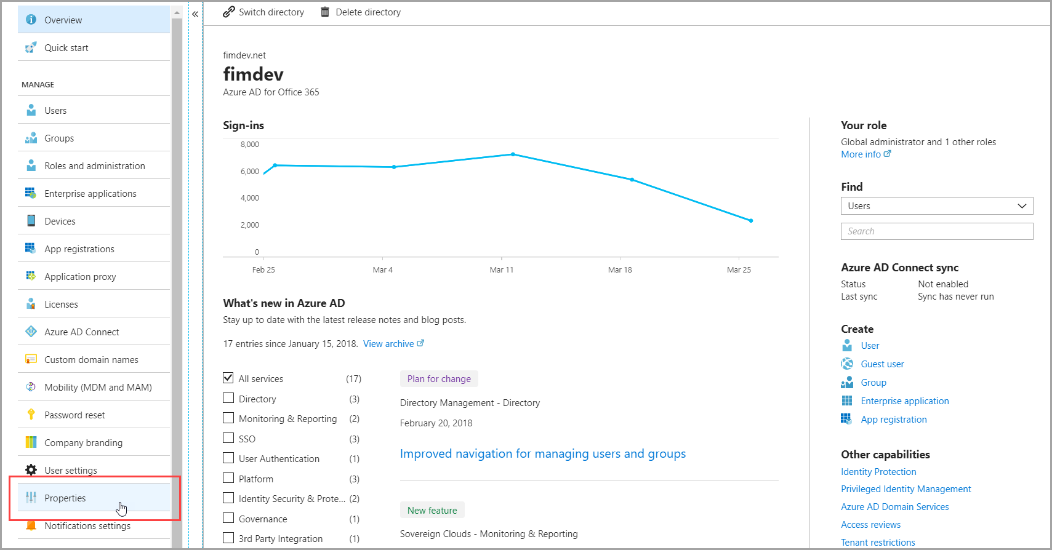
Notes:
Enable subscription management in your tenant https://docs.microsoft.com/en-us/azure/active-directory/privileged-identity-management/pim-resource-roles-enable-subscription-management
Sign in as Global Admin
Access the Azure Active Directory admin center

Slide 65
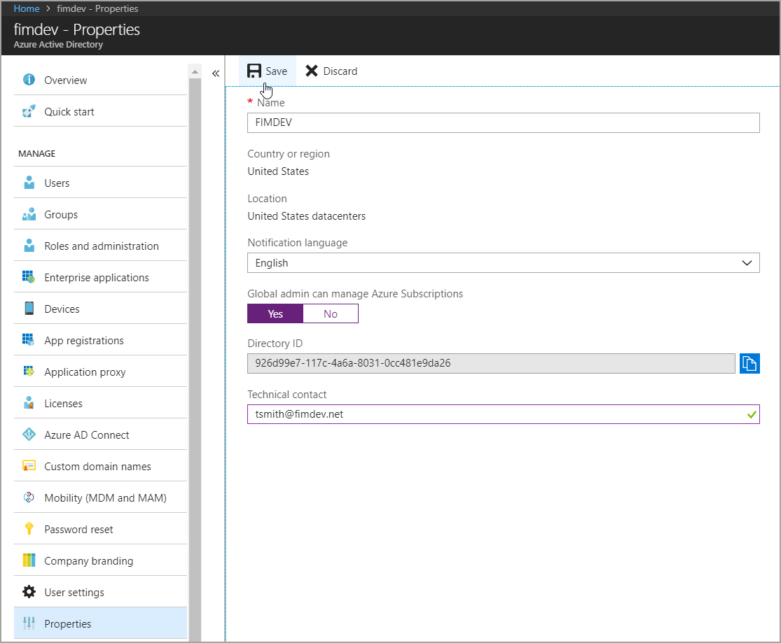
Notes:
Enable subscription management in your tenant https://docs.microsoft.com/en-us/azure/active-directory/privileged-identity-management/pim-resource-roles-enable-subscription-management

Slide 66

Azure Government Roles & Azure Active Directory (AAD) Associations
Enterprise Portal
Account Portal
Azure Portal
Tenant Organizational Roles
Enterprise Admin
Can add other Enterprise and Department Administrators, add Departments, add or associate Accounts to the Enrollment, can view usage and charges data across all Accounts and Subscriptions, can view the monetary commitment balance associated to the Enrollment. There is no limit to the number of Enterprise Administrators on an Enrollment.
GOV
AAD
O365
AAD
Department Admin
Can edit their department name and cost center, manage department admins, add accounts to the enrollment and their departments, remove accounts from their departments and view Department charges if enabled by the Enterprise Admin.
GOV
AAD
O365
AAD
Account Owner
Can add subscriptions to the account, update the Service Administrator and Co-Administrator for an individual subscription, view usage data for their Account, and view Account charges if enabled by the Enterprise Administrator. The Account Owner will not have visibility of the monetary commitment balance unless they also have Enterprise Administrator rights.
Need to find Roles for Azure Enterprise
GOV
AAD
Subscription Admin
Has the ability to access and manage Subscriptions and development projects within the Azure Management Portal. The Service Administrator does not have access to the Enterprise Portal unless they have either Enterprise Admin or Department Admin roles
GOV
AAD
Global Admin
Has the ability to create additional and delete users/identities within the Azure Government Active Directory tenant associated with your Azure Government environment. Can also reset user passwords.
GOV
AAD
User
This is the role that is used when setting up an identity within the Azure Government Active Directory for all Account Owners, Service Admins and Co-Admins
GOV
AAD
Note: Additional Role Based Authentication Control (RBAC) roles can be found here

Slide 67
Module 1 - Azure Governance
Section 2
RBAC and Resource Lock
Notes:
RBAC is present in every Azure service and it is the foundation for securing your resources by granting the appropriate access level required to securely manage your environment.
Differently from an on premises Active Directory where you would need to deploy extra solutions (i.e. MIM) to achieve RBAC functionality, in Azure there are pre-defined groups with their corresponding permission levels ready to use, as well as the possibility to customize your own RBAC model according to your needs.
Please update the content of this slide Add the other objectives

Slide 68
Azure Role-Based Access Control (RBAC)
Fine-grained access control to Azure “control plane”
Grant access by assigning Security Principal a Role at a Scope
Security Principal: User, group, or service principal
Role: Built-in or custom role
Scope: Subscription, resource group, or resource
Assignments are inherited down the resource hierarchy
https://aka.ms/azureiam
Notes:
Using RBAC, you can segregate duties within your team and grant only the amount of access to users that they need to perform their jobs. Instead of giving everybody unrestricted permissions in your Azure subscription or resources, you can allow only certain actions at a particular scope.
<CLICK1>
Security principal
A security principal is an object that represents a user, group, service principal, or managed identity that is requesting access to Azure resources.
- Service principal - A security identity used by applications or services to access specific Azure resources. You can think of it as a user identity (username and password or certificate) for an application.
Managed identity - An identity in Azure Active Directory that is automatically managed by Azure. You typically use managed identities when developing cloud applications to manage the credentials for authenticating to Azure services.
<CLICK2>
Role definition
A role definition is a collection of permissions. It's sometimes just called a role. A role definition lists the operations that can be performed, such as read, write, and delete. Roles can be high-level, like owner, or specific, like virtual machine reader. You can create custom roles if none of the existing built-in roles don't meet the specific needs of your organization.
<CLICK3>
Scope
Scope is the boundary that the access applies to. When you assign a role, you can further limit the actions allowed by defining a scope. This is helpful if you want to make someone a Website Contributor, but only for one resource group.

Slide 69

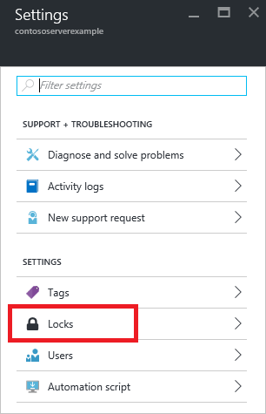
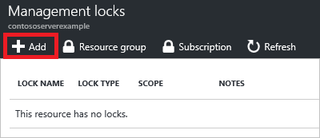
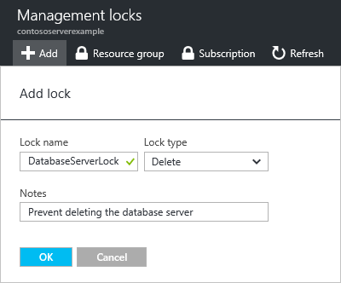
Resource Lock
BEST PRACTICE
CHOICE
Lock a Subscription, resource group, or resource to prevent accidental deletion or modification.
CanNotDelete / ReadOnly
Locks apply only to management operations, not to resources functions
Caution: ReadOnly can cause unexpected results
Lock on a storage account prevents all users from listing keys
Lock on App Service prevents Visual Studio Server Explorer from displaying files for the resource because that interaction requires write access
Notes:
https://docs.microsoft.com/en-us/azure/azure-resource-manager/resource-group-lock-resources
How locks are applied
When you apply a lock at a parent scope, all resources within that scope inherit the same lock. Even resources you add later inherit the lock from the parent. The most restrictive lock in the inheritance takes precedence.
Unlike role-based access control, you use management locks to apply a restriction across all users and roles. To learn about setting permissions for users and roles, see Azure Role-based Access Control.
Resource Manager locks apply only to operations that happen in the management plane, which consists of operations sent to https://management.azure.com. The locks do not restrict how resources perform their own functions. Resource changes are restricted, but resource operations are not restricted. For example, a ReadOnly lock on a SQL Database prevents you from deleting or modifying the database, but it does not prevent you from creating, updating, or deleting data in the database. Data transactions are permitted because those operations are not sent to https://management.azure.com.
Applying ReadOnly can lead to unexpected results because some operations that seem like read operations actually require additional actions. For example, placing a ReadOnly lock on a storage account prevents all users from listing the keys. The list keys operation is handled through a POST request because the returned keys are available for write operations. For another example, placing a ReadOnly lock on an App Service resource prevents Visual Studio Server Explorer from displaying files for the resource because that interaction requires write access.

